Slide 1
Brain Oxygen Optimization in Severe Traumatic Brain Injury

Slide 2
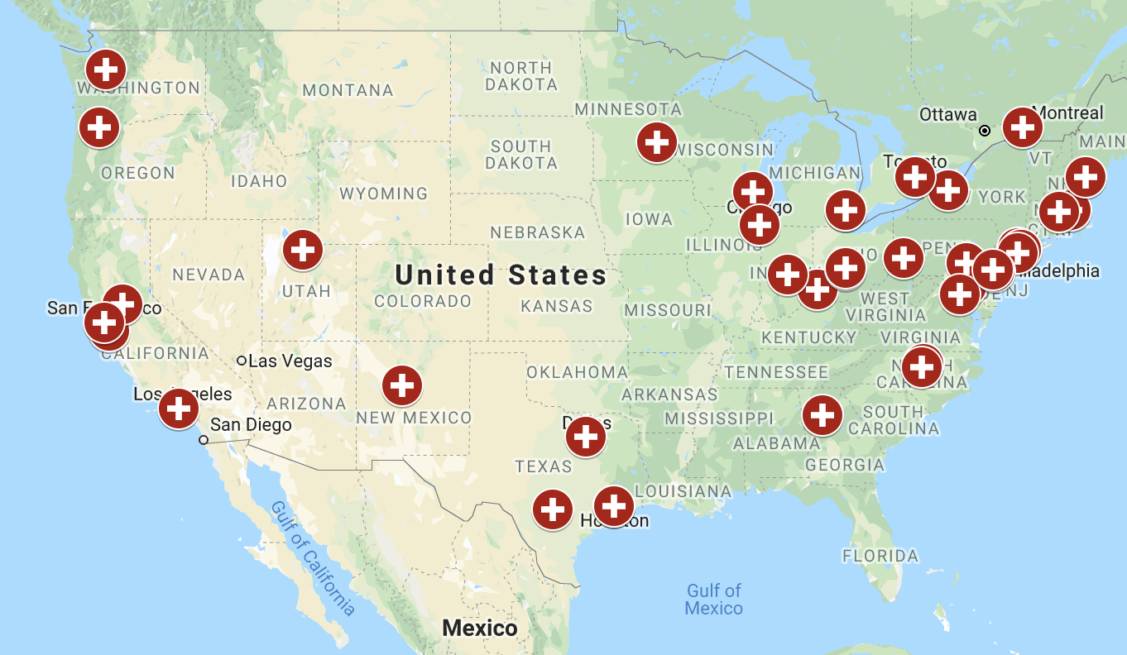

Slide 3

Who WILL be included in this study?
Anybody who is 14 years or older with
Blunt closed head trauma, with
Severe brain injury, and who
Is having brain probes placed immediately (typically within 2 to 10 hours of injury)
Notes:
WHO WILL BE INCLUDED IN THIS STUDY?
Any patient who is 14 years or older with a
Blunt closed head injury, with
Severe brain injury, and
Can start the study immediately following brain monitor placement.

Slide 4
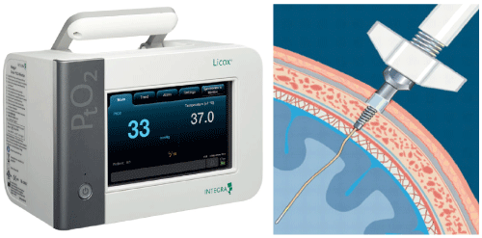
How will the study work?
Screen for eligibility
Everyone will be treated for their TBI
Eligible patients are those already getting two probes placed
    ICP (intracranial pressure) probe
    Brain tissue oxygen (PbtO2) probe
Notes:
Every patient coming to the ED who is eligible will be considered.
Everyone in this study will be treated for their TBI.
Everyone will have two probes placed:
ICP (intracranial pressure) probe
Brain tissue oxygen (PbtO2) probe

Slide 5

Special requirements for EFIC
Community consultation (why we are here)
Public disclosure before and after the study
Oversight during the study
Notes:
We have to do….
during the study, a group of experts will watch over the study and stop it if it is clearly helping or hurting people.

Slide 6


The Study

Slide 7
Topics for today
Traumatic brain injury (TBI)
The BOOST3 study
Emergency research and consent
Notes:
Traumatic brain injury (TBI)
TBI Research
BOOST3 – a TBI study
Emergency Research & Consent – How is this research study different from most?

Slide 8
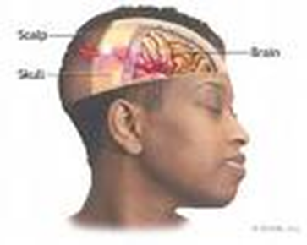
What is Traumatic Brain Injury (TBI)?
Traumatic Brain Injury is sudden damage to the brain caused by an outside force - such as a car crash, a fall, or something hitting the head.

Slide 9

TBI is the leading cause of death in children and adults ages 1 to 44 years
Every 15 seconds, someone in the US suffers a major TBI!
Every 5 minutes, someone is forever disabled as a result of TBI.

Slide 10
What problems does TBI cause?
Death
Coma
Inability to think clearly
Memory loss
Impaired balance and coordination
Inability to return to work
Inability to live independently
Notes:
WHAT ARE THE DANGERS OF TBI?
TBI can:
Change the ability to think and remember things
Cause problems with balance, coordination, fine motor skills (like writing or tying a shoe), & strength
Keep a person from being able to return to work or from functioning normally and independently
Limit awareness and cause coma
Cause permanent brain damage
Cause death

Slide 11
Does anyone here know someone who suffers from a brain injury?

Slide 12
Treatment of Severe TBI
Ventilators
Lots of tubes, lines, and monitors
Goal directed care
Brain pressure
Brain oxygen levels
Notes:
HOW IS SEVERE TBI TREATED?
The current treatment is to control blood pressure and brain swelling to try to limit the amount of damage to the brain.
Some doctors also try to control the oxygen level in the brain. If the amount of oxygen in the brain gets too low, additional brain injury is possible.

Slide 13
A research study designed to learn if either of two alternative strategies for monitoring and treating patients with TBI in the intensive care unit (ICU) is more likely to help them get better.
Notes:
A research study designed to find out if treating low brain oxygen in TBI patients can reduce the amount of brain damage and improve outcomes.

Slide 14
Who will NOT be included in the study
Children less than 14 years of age
Women known to be pregnant
Prisoners or others in police custody
Those wearing a medical alert “opt-out”
Notes:
WHO CANNOT BE IN THIS STUDY?
Any persons less than 14 years of age
Women known to be pregnant
Prisoners of anyone known to be in police custody
Patients who have said they do not want to be in the study by wearing an opt-out bracelet

Slide 15

Participants placed in one of two groups
Which group is determined by chance,
like flipping a coin
  Group 1: Care based on monitoring of pressure in the brain (intracranial pressure or ICP) alone.
  Group 2: Care based on the monitoring of both ICP and the amount of oxygen in the brain (brain tissue oxygen or PbtO2).

Slide 16
What else will happen in this study?
  Participants in both study groups will:
Receive TBI care guided by probe data for up to five days.
Blood or cerebrospinal fluid (CSF) may be collected for research purposes.
Be called every month after injury for 5 months to see how they are doing.
Be asked to return to the clinic 6 months after their brain injury to take a series of paper and pencil tests.

Slide 17
How are emergency studies different?
In most studies, investigators explain what will happen, describe possible risks and possible benefits, answer questions, and then the eligible patients decide whether to participate. This process is called Informed Consent.
In this emergency study, eligible patients are unconscious and cannot decide or communicate whether or not they wish to participate in a study. Also, treatment is started emergently often before family or other representatives are available to decide for the patient.
Notes:
In other studies,
A study investigator explains the study and its risks and benefits.
The person is able to ask questions about the study.
The person decides to be in the study or not.
This process is called INFORMED CONSENT.
In this study,
Patients with a traumatic brain injury are unconscious and cannot give permission to participate in the study.
Also, treatment has to be started quickly. Therefore, there may not be time to explain the study to family and ask for their consent for the patient to participate.

Slide 18
So how do we do emergency research?
Specific federal regulations allow an
Exception From Informed Consent for emergency research
EFIC is only allowed when:
The condition being studied is life-threatening
Existing treatments are unproven or inadequate
There is potential benefit to participants
Getting consent is not possible
Notes:
EFIC can only be used when:
The person’s life is at risk, AND
The best treatment is not known, AND
The study might help the person, AND
It is not possible to get permission:
from the person because of his or her medical condition, or
from the person’s family because the medical condition needs to be treated very quickly.

Slide 19
How does EFIC work in BOOST3
If a family member or representative is available, they will decide for the patient
If not, eligible patients will be started in the study without consent
Family members or representatives are told about the study as soon as possible and asked whether participation can continue
Notes:
Because TBI must be treated quickly, study protocol management of the TBI will need to be started as soon as the ICP and Pbt02 probes are placed.
Since the injured person will not be awake to give permission, study team members will try to locate a legally authorized representative (LAR) to get his/her permission to enter the patient into the study in advance.
If the LAR cannot be located before the probes are placed, the patient will be started on the study protocol without consent.
Once the LAR is located, he/she will be asked to give permission for the patient to continue in the study.
If the LAR does not give permission, the study protocol will be stopped.
If the patient continues in the study, he or she will be monitored by the study team until leaving the hospital.

Slide 20
What if I don’t want to be in the study?
Ask us for a medical alert bracelet that says “BOOST-3 study declined” or add those words to your existing medical-alert notification.
In the event you suffer a severe traumatic brain injury, you will not be enrolled in the study if you are wearing that medical alert notification when you arrive at the hospital.

Slide 21
What do you think about BOOST-3?
The study has not started yet, so . . .
We want to hear your thoughts.
Tell us about your experiences.
Do you think it is okay to do this study?
The study team and the research review board will consider your opinions before deciding if it is okay to do in our community.

Slide 22


Questions?
If you have any questions, comments, or concerns about the study, please speak with us now and/or contact us at:
boost3@uchicago.edu
    boost3trial.org

